Slide 1
Security and Authorization
Chapter 5
Notes:
1

Slide 2
Chapter outline
Introduction to DB Security
Security Levels
Access Controls
GRANT and REVOKE of Privileges
GRANT/REVOKE on Views
Role-Based Authorization

Slide 3
Introduction to DB Security
Secrecy: Users should not be able to see things they are not supposed to.
  E.g., A student can’t see other students’ grades.
Integrity: Users should not be able to modify things they are not supposed to.
  E.g., Only instructors can assign grades.
Availability: Users should be able to see and modify things they are allowed to.

Slide 4
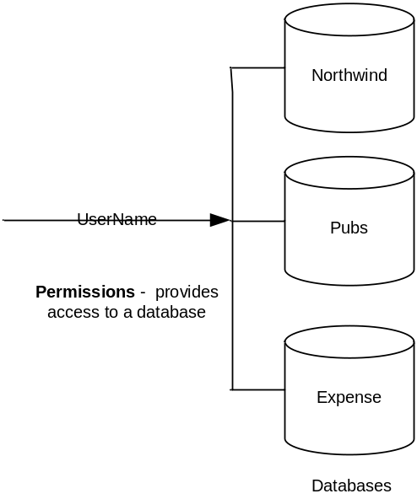
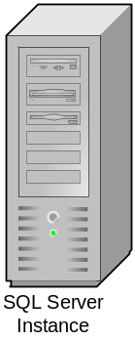

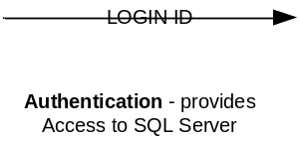
Security Levels
A user passes through 2 stages of security in DBMS
  Authentication – validates that a user can connect to a SQL Server instance (Login)
  Authorization – permissions validation; controls the activities the user is allowed to perform in the SQL Server database (User)

Slide 5
Access Controls
A security policy specifies who is authorized to do what.
A security mechanism allows us to enforce a chosen security policy.
Two main mechanisms at the DBMS level:
  Discretionary access control
  Mandatory access control

Slide 6
Discretionary Access Control
Based on the concept of access rights or privileges for objects (tables and views), and mechanisms for giving users privileges (and revoking privileges).
Creator of a table or a view automatically gets all privileges on it.
  DMBS keeps track of who subsequently gains and loses privileges, and ensures that only requests from users who have the necessary privileges (at the time the request is issued) are allowed.

Slide 7
GRANT Command
GRANT privileges ON object TO users [WITH GRANT OPTION]
The following privileges can be specified:
  SELECT: Can read all columns (including those added later via ALTER TABLE command).
  INSERT(col-name): Can insert tuples with non-null or non-default values in this column.
    INSERT means same right with respect to all columns.
  DELETE: Can delete tuples.
  REFERENCES (col-name): Can define foreign keys (in other tables) that refer to this column.
If a user has a privilege with the GRANT OPTION, can pass privilege on to other users (with or without passing on the GRANT OPTION).
Only owner can execute CREATE, ALTER, and DROP.

Slide 8
Revoking Privileges
REVOKE <list of privileges>
ON <relation or other object>
FROM <list of authorization ID’s>;
Your grant of these privileges can no longer be used by these users to justify their use of the privilege.
  But they may still have the privilege because they obtained it independently from elsewhere.

Slide 9
REVOKE Options
We must append to the REVOKE statement either:
  CASCADE. Now, any grants made by a revokee are also not in force, no matter how far the privilege was passed.
  RESTRICT. If the privilege has been passed to others, the REVOKE fails as a warning that something else must be done to “chase the privilege down.”

Slide 10
GRANT and REVOKE of Privileges
Examples
GRANT INSERT, SELECT ON Sailors TO Horatio
  Horatio can query Sailors or insert tuples into it.
GRANT DELETE ON Sailors TO Yuppy WITH GRANT OPTION
  Yuppy can delete tuples, and also authorize others to do so.
GRANT UPDATE (rating) ON Sailors TO Dustin
  Dustin can update (only) the rating field of Sailors tuples.
GRANT SELECT ON ActiveSailors TO Guppy, Yuppy
  This does NOT allow the ‘uppies to query Sailors directly!
Notes:
23

Slide 11
Example: Privileges
For the statement below:
INSERT INTO Beers(name)
SELECT beer FROM Sells
WHERE NOT EXISTS
(SELECT * FROM Beers
WHERE name = beer);
We require privileges SELECT on Sells and Beers, and INSERT on Beers or Beers.name.
beers that do
not appear in
Beers. We add
them to Beers
with a NULL
manufacturer.

Slide 12
Example: Grant Diagram
A: GRANT P
TO B WITH
GRANT OPTION
B: GRANT P
TO C WITH
GRANT OPTION
AP**
BP*
CP*
A owns the
object on
which P is
a privilege
CP
A: GRANT P
TO C

Slide 13
Example: Grant Diagram
Not only does B lose
P*, but C loses P*.
Delete BP* and CP*.
A executes
REVOKE P FROM B CASCADE;
AP**
BP*
CP*
Even had
C passed P
to B, both
nodes are
still cut off.
CP
However, C still
has P without grant
option because of
the direct grant.

Slide 14
GRANT/REVOKE on Views
If the creator of a view loses the SELECT privilege on an underlying table, the view is dropped!
If the creator of a view loses a privilege held with the grant option on an underlying table, (s)he loses the privilege on the view as well; so do users who were granted that privilege on the view!

Slide 15
Views and Security
Views can be used to present necessary information (or a summary), while hiding details in underlying relation(s).
Creator of view has a privilege on the view if (s)he has the privilege on all underlying tables.
Together with GRANT/REVOKE commands, views are a very powerful access control tool.
Notes:
22

Slide 16
Authorization ID’s
A user is referred to by authorization ID, typically their login name.
There is an authorization ID: PUBLIC.
  Granting a privilege to PUBLIC makes it available to any authorization ID.

Slide 17
Role-Based Authorization
In SQL-92, privileges are actually assigned to authorization ids, which can denote a single user or a group of users.
In SQL:1999 (and in many current systems), privileges are assigned to roles.
  Allow you to collect users into a single unit against which you can apply permissions
  Permissions are applied automatically when the users become members of the role
  Roles can then be granted to users and to other roles.
  Reflects how real organizations work.
  Illustrates how standards often catch up with “de facto” standards embodied in popular systems.

Slide 18
Summary
Three main security objectives: secrecy, integrity, availability.
DB admin is responsible for overall security.
  Designs security policy, maintains an audit trail, or history of users’ accesses to DB.
Two main approaches to DBMS security: discretionary and mandatory access control.
  Discretionary control based on notion of privileges.
  Mandatory control based on notion of security classes.
Statistical DBs try to protect individual data by supporting only aggregate queries, but often, individual information can be inferred.

Slide 19
Assigments
Grant and Revoke in SQL Server or Oracle.
Roles: Server roles, Database roles, Application Roles (Fixed roles và user defined roles)
Roles in security
Creating and management Roles in SQL-Server or Oracle (with Management Studio or transaction (SQL-Server))

